Slide 1
PRESENTATION ON BINARY SEARCH TREES
Submitted to : submitted by:
prof. indu Chhabra anupreet kaur
komal mittal
sadaf

Slide 2
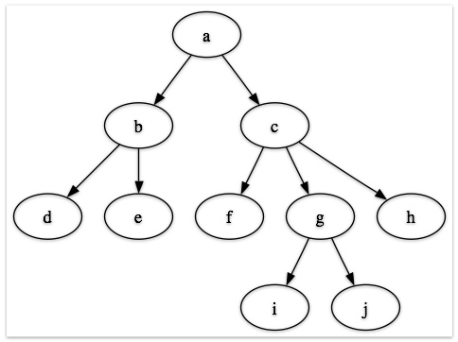
What is a tree?
tree is:
A non linear data structure
A hierarchical structure of data
A graph without cycles

Slide 3
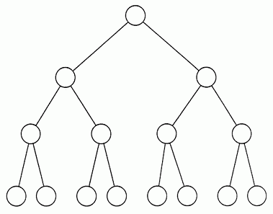
What is a binary tree?
A binary tree is a finite set of elements that is either empty or disjoint into three subsets.
The first subset is the root of binary tree.
The second subset is the right subtree.
The third subset is the left subtree.
A binary tree is a tree in which degree of every node
Is Less than or equal to 2.
Deg(node of bt)<=2

Slide 4
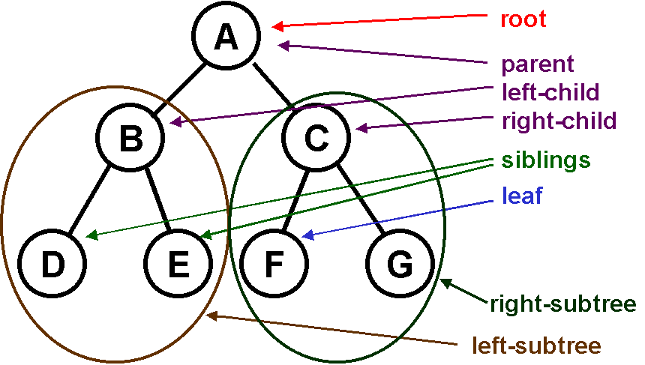
Basic concepts of binary trees
Root
Left subtree and right subtree
Parent node
Siblings
Leaf or terminal node

Slide 5
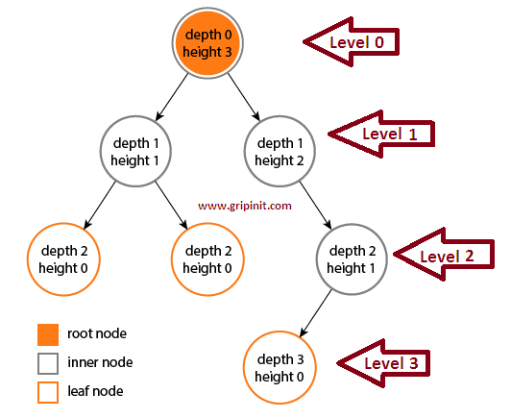
BASIC CONCEPTS OF BINARY TREE
Height
Depth
Level

Slide 6
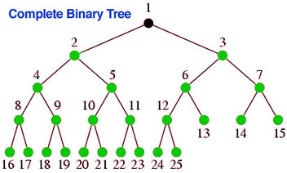
COMPLETE BINARY TREE
A tree is said to be complete if it has maximum number of nodes (that is 2) at each level except the last level.
A complete tree of depth N has maximum {2^(N+1)} - 1 nodes.

Slide 7
Representation of algebraic expression into a binary tree
For example:
a-b
a-b/c
(a-b)*c

Slide 8
Memory representation of Binary tree
Array representation
Link list representation

Slide 9
Array representation of binary tree (sequential representation)
Let K is the index position of the parent node, then left and right child will store at their corresponding position calculated by 2K and 2K+1 respectively.
*In this 0th position is ignored or left NULL
H
D
A
F
O
P
NULL
1
2
3
4
5
6
7
INDEX | 0 | 1 | 2 | 3 | 4 | 5 | 6 | 7
VALUES |  | H | D | 0 | A | F |  | P

Slide 10
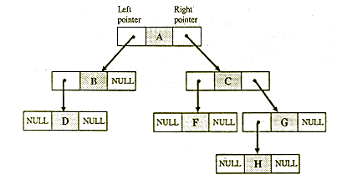

LINKED LIST REPRESENTATION OF BINARY TREE
In link list each node is represented by a structure having three fields or members.

Slide 11
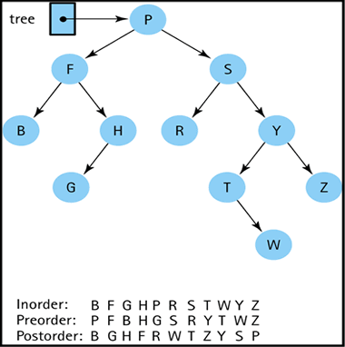
BINARY TREE TRAVERSAL
THERE ARE THREE STANDARD WAYS OF TRAVERSING A BINARY TREE –
PREORDER TRAVERSAL
VISIT ROOT
TRAVERSE THE LEFT SUBTREE IN PRE-ORDER
TRAVERSE THE RIGHT SUBTREE IN PRE-ORDER
INORDER TRAVERSAL
TRAVERSE THE LEFT SUBTREE IN IN-ORDER
VISIT THE ROOT NODE
TRAVERSE THE RIGHT SUBTREE IN IN-ORDER
POSTORDER TRAVERSAL
TRAVERSE THE LEFT SUBTREE IN POST-ORDER
TRAVERSE THE RIGHT SUBTREE IN POST-ORDER
VISIT THE ROOT NODE

Slide 12
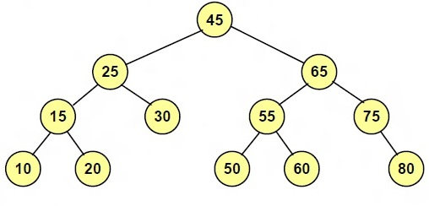
BINARY SEARCH TREE

Slide 13



Binary search tree (bst)
It is a non linear data structure for efficient searching, insertion and deletion.
Binary search tree property-
For every node X
All the keys in its left subtree are smaller than the key value in X.
All the keys in its right subtree are larger than or equal to the key value in X.
X
For any node Y in subtree
key(Y) < key(X)
For any node Z in subtree
key(Z) > key(X)

Slide 14

BinARY Search tree and non-binary search tree (example)
10
10
5
45
5
30
2
25
30
2
25
45
Binary Search Tree
Not a Binary Search Tree

Slide 15
Operations on binary search tree
OPERATIONS
SEARCHING
INSERTION
DELETION
TRAVERSING

Slide 16
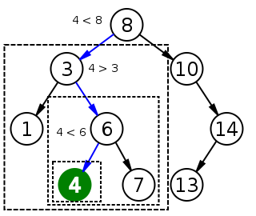
SEARCHING
Suppose N is to be searched, following actions are taken:
1). Compare N with root node.
If root < N, look to right subtree of root.
If root > N, look to left subtree of root.
2). Repeat step 1 until :
We get a node N that is search is successful
We don’t get node N that is search is unsuccessful.

Slide 17
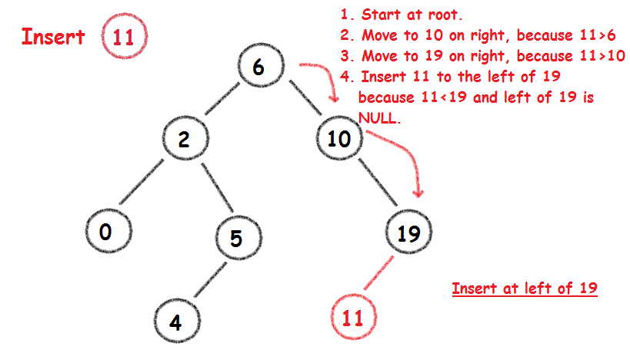
insertion
to insert a data in BST we must have to find out the position of data to be inserted
There can be following conditions if we insert a data item in the BST with rOOT node as root:
If tree is empty that is root is null then, new node becomes the root
The new node can be added to left of the root
The new node can be added to right of the root.

Slide 18
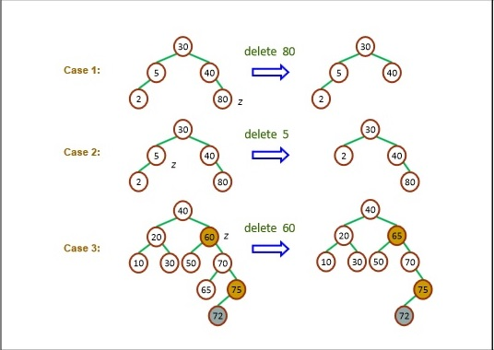
deletion
Deletion of a item from a bst is a two stage process:
Search for a node to remove
If node is found, it can be remove in following cases:
Case 1: Node to be deleted having no children
Case 2: node to be deleted having exactly one child
Case 3: node to be deleted having two children

Slide 19
Case 1: suppose node to be deleted is n, we simply replace parent location of n with null pointer. case 2: suppose node m to be deleted having exactly one child, we simply replace the address of m in its parent node with address of its child. case 3: suppose node to be deleted is p, having two children. To delete it we have to find the inorder successor of p and replace it. After it we simply delete the inorder successor which we previously find.

Slide 20
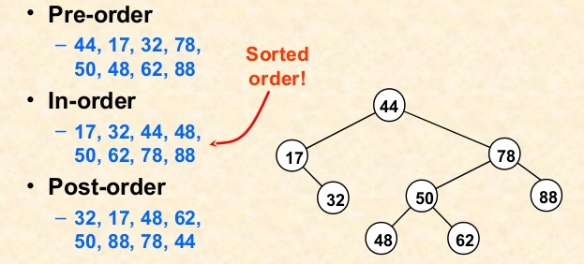

traversing
Pre-order traversal:
(root, left ,right)
In-order traversal:
(left, root, right)
Post-order traversal:
(Left, right, root)

Slide 21
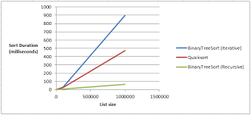
applications
1).
BST are collections that can efficiently maintain a dynamically data set in sorted order for some sortable type.

Slide 22
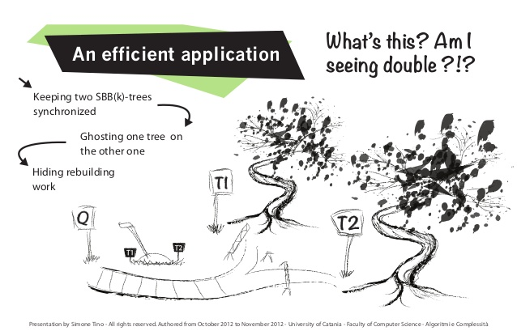
applications
2).
It prevents duplicated copy of data elements.

Slide 23
applications
3). For search queries fired to server by clients.
4). Software for dictionary, telephone contacts, address book, medical store, etc.
5). For indexing files in memory map by using advanced search tree like B, B+.
6). Used in UNIX kernel for managing a set of virtual memory areas[VMAs]. Each VMA represents a section of memory in a UNIX PROCESS.

Slide 24


